Slide 1


Tock OS
Alexandru Radovici
Tockworld 6 - 2023

Slide 2
“
An embedded operating system designed for running multiple concurrent, mutually distrustful applications on low-memory and low-power microcontrollers.

Slide 3
TockOS
A pre-emptive embedded OS (runs on MCUs)
  Cortex-M
  RISC-V
Uses memory protection (MPU required)
Has separate kernel and user space
  most embedded OS have the one piece software philosophy
Runs untrusted apps in user space
Kernel (and drivers) written in Rust
Apps written in C/C++ or Rust (any language that can be compiled)

Slide 4
Functional Components
Applications
  user space processes
  any language
  independent executable
Capsules
  hardware independent drivers
  inside the kernel
  safe rust
HAL
  hardware dependent driver
  unsafe rust
System calls (syscall)
Hardware Interface Layer (HIL)

Slide 5
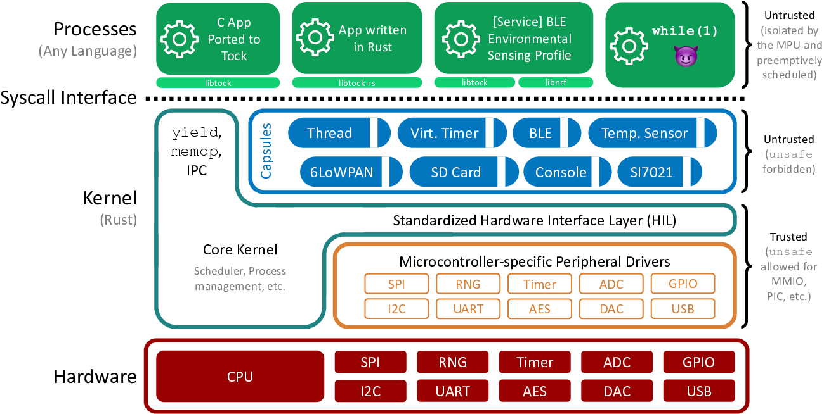
Architecture
Image from https://github.com/tock/tock/blob/master/doc/Overview.md

Slide 6
Kernel
Non pre-emptive
  capsules (drivers) run to completion
  async API
Does not allocate dynamic memory
  only static buffers
  no out of memory errors in kernel
Grants
  memory for capsules in user processes
  allocated at the start of a process (if possible)

Slide 7


Used by
Open-source implementation for security keys written in Rust that supports both FIDO U2F and FIDO2 standards.
Google Inc.
The first open source project building a transparent, high-quality reference design and integration guidelines for silicon root of trust (RoT) chips.
LowRISC, ETH Zurich, G+D Mobile Security,
Google, Nuvoton, Western Digital

Slide 8
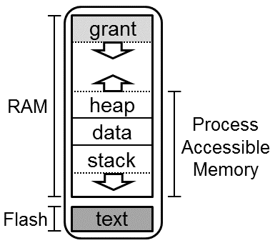
Application (Process)
Standalone executable
  compiled without TockOS kernel
Memory Protection
  MPU Regions
Can (seg)fault
Relocatable code
  where the compiler allows it
IPC
  service discovery

Slide 9
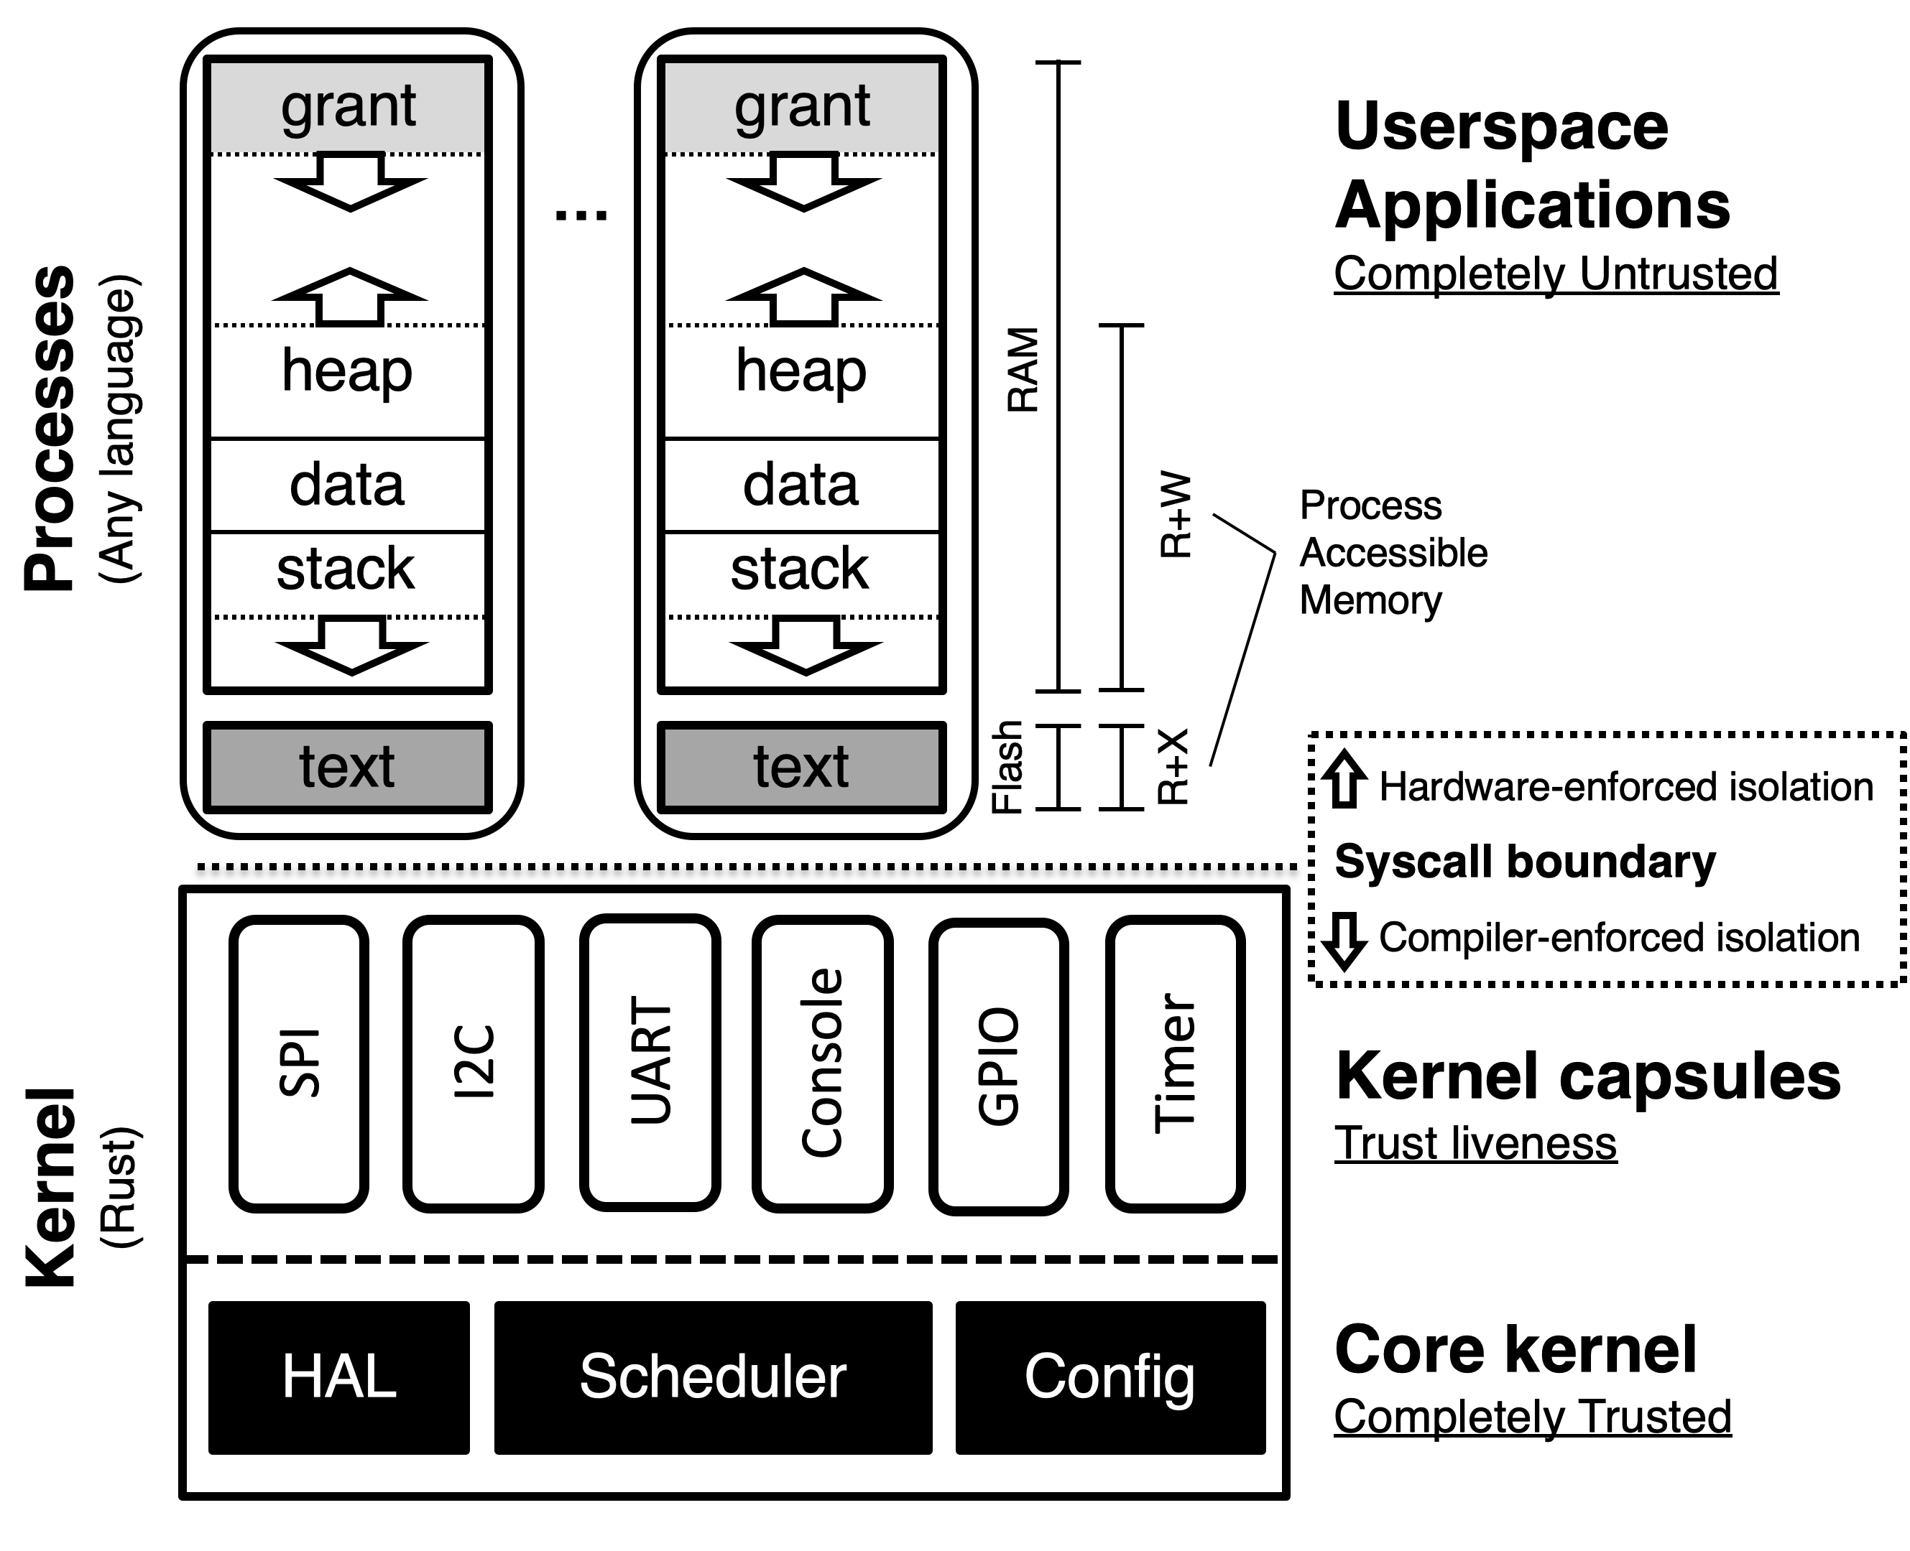
Memory
Image from https://github.com/tock/tock/blob/master/doc/Design.md

Slide 10
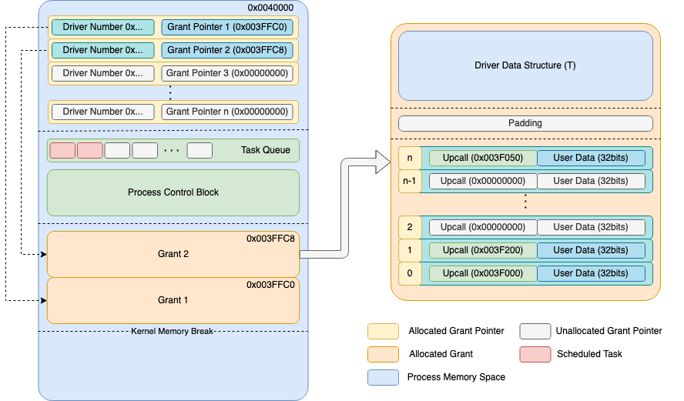
Grant

Slide 11
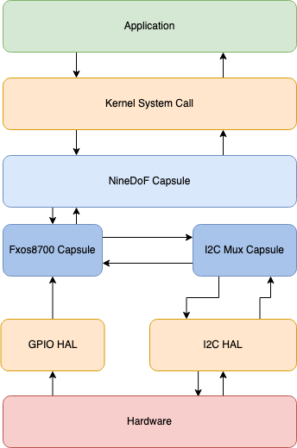
Only 7 Syscalls
0 – Yield
1 – Subscribe
2 – Command
3,4 – Allow
5 – Memop
6 – Exit

Slide 12
Yield
Processes have a callback queue
  similar with an event loop system
Suspends the process until a callback is available
Callbacks are called only when the process is yielded
  when main returns, libtock-c runs while (true) yield();

Slide 13
Subscribe
The process registers a callback function
Parameters
  capsule_number – id of the driver
  subscribe_number – a sub_command number, specific to the driver
  callback – pointer to a function or NULL
  user_data – any pointer

Slide 14
Command
The process sends a command to a driver
  similar with ioctl from Linux
Parameters
  capsule_number – id of the driver
  command_number – a command_command number, specific to the driver
  data1 – usize parameter
  data2 – usize parameter

Slide 15
ReadWrite/ReadOnly Allow
The process shares a buffer with a driver
Parameters
  capsule_number – id of the driver
  allow_number – an allow_command number, specific to the driver
  pointer – pointer to the buffer data
  size – size of the buffer data

Slide 16
Memop
The process requests a memory action
  similar with brk and sbrk from Linux
Parameters
  op_type – action id
  argument – usize parameter

Slide 17
Exit
Stop or restart the process
Parameters
  restart – action id
  completion_code – usize

Slide 18
Full system call

Slide 19
Userland libraries
LibTock-C
LibTock-RS
Stable (recommended)
newlib
  libc
  libm
libc+
  Lua53
  LittlevGL
RV32: issue with code relocation
not stable yet
core
  active development
issue with relocation
  Compiler problem

Slide 20
Tock Executable
Tock Binary Format
  TBF
  Tock header with memory and loading requirements
  Process binary
Tock Application Bundle
  TAB
  several TBF files for several architectures
  ARM M0, M3, M4, RV32-IMAC and RV32-IMC

Slide 21

Tockloader
Manage Tock OS Application
Uses TAB files
Written in Python
Needs implementation for several boards
Small App Store

Slide 22
Future Plans
In Progress
  Ethernet for STM32
  WiFi for Raspberry Pi Pico W
  Tockloader Rust version

Slide 23
www.tockos.org
Thank you

